Slide 1

The Repeat Shopper Prediction Analysis
Manasa M 1MS12CS052
Mounica Naidu M 1MS12CS059
Nikhita Jayakumar 1MS12CS067
Rajath Jain 1MS12CS086

Slide 2
Project Goals
The challenge was to predict which shoppers that responded to a rebate coupon on a specific product, would become repeat buyers of that product.
The given dataset was a 22 GB dataset with one year history of transactions for each shopper.
Given offers how many customers would visit the store again .
The brand which a revisiting customer may choose
The category which revisiting customer may choose.

Slide 3

Description about the Data Sets
transactions.csv - contains transaction history for all customers for a period of at least 1 year prior to their offered incentive
trainHistory.csv - contains the incentive offered to each customer and information about the behavioural response to the offer
testHistory.csv - contains the incentive offered to each customer but does not include their response (you are predicting the repeater column for each id in this file)
offers.csv - contains information about the offers

Slide 4
Description about the SRS
A software requirements specification (SRS) is a description of a software system to be developed, laying out functional and non-functional requirements, and may include a set of use cases that describe interactions the users will have with the software.
Min 4GB ram to process the 22GB dataset file (transactions.csv) .
Python installed
Vowpal Wabbit library

Slide 5
Description about the Design Architecture with Sequence Diagram
Number of modules :
reduce_data
generate_features
diff_days
amount
quantity

Slide 6
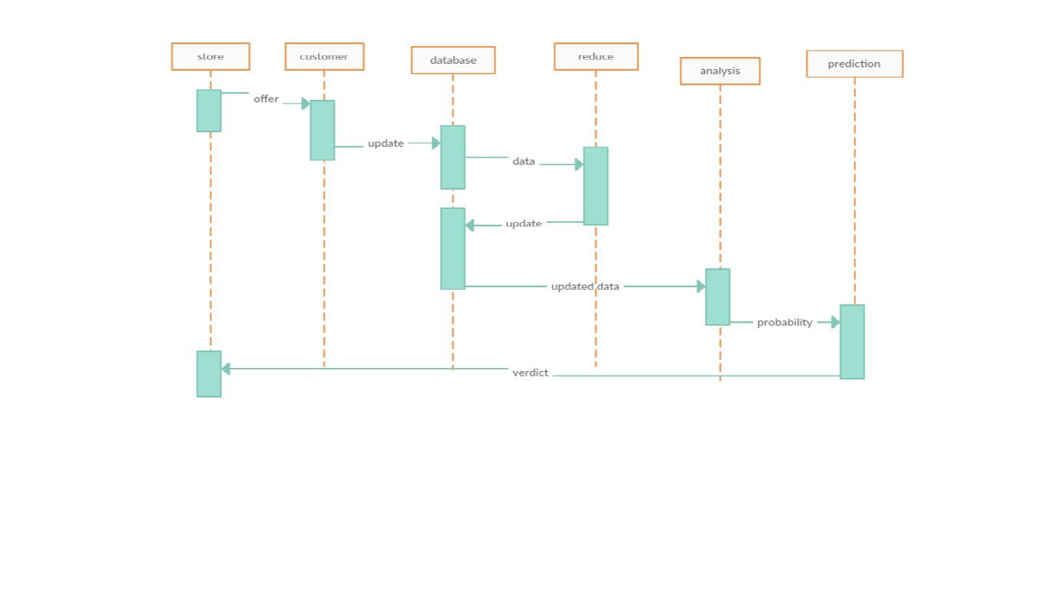
Sequence Diagram

Slide 7
Implementation details
A short description
The challenge was to predict which shoppers that responded to a rebate coupon on a specific product, would become repeat buyers of that product.
Our task is to predict the labels for a file called transactions.csv. It’s a huge file (unzipped about 22GB) containing nearly 350 million rows. The total amount spend in the transaction data is nearing 1.5 billion.
Data exploration
transactions.csv - contains transaction history for all customers.
trainHistory.csv - contains the incentive offered to each customer and information about the behavioral response to the offer
testHistory.csv - contains the incentive offered to each customer but does not include their response
offers.csv - contains information about the offers

Slide 8
Data reduction
offers.csv file has all the categories and companies a coupon offer can have. We discard the rows from the transactions data which don’t have a category id or a company id which is on offer.
The function reduce_data() can do the above. It runs in about 5-10 minutes and will reduce the ~350 million rows to ~27 million rows. This makes our future model code more manageable (around 1.6GB).
Apart from this we have used
Vowpal-wabbit
Feature engineering
Python
R
Various libraries in python like Scipy, Numpy, mathplotlib ectc

Slide 9
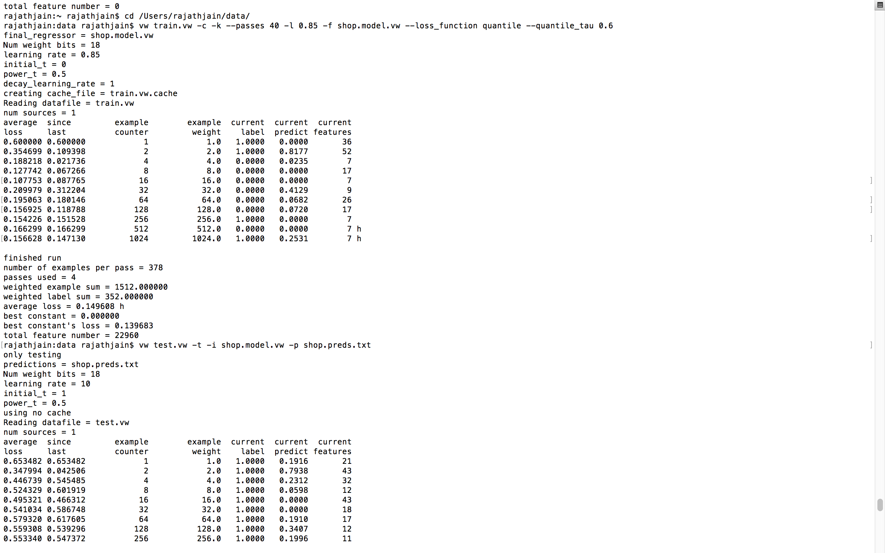
Results

Slide 10
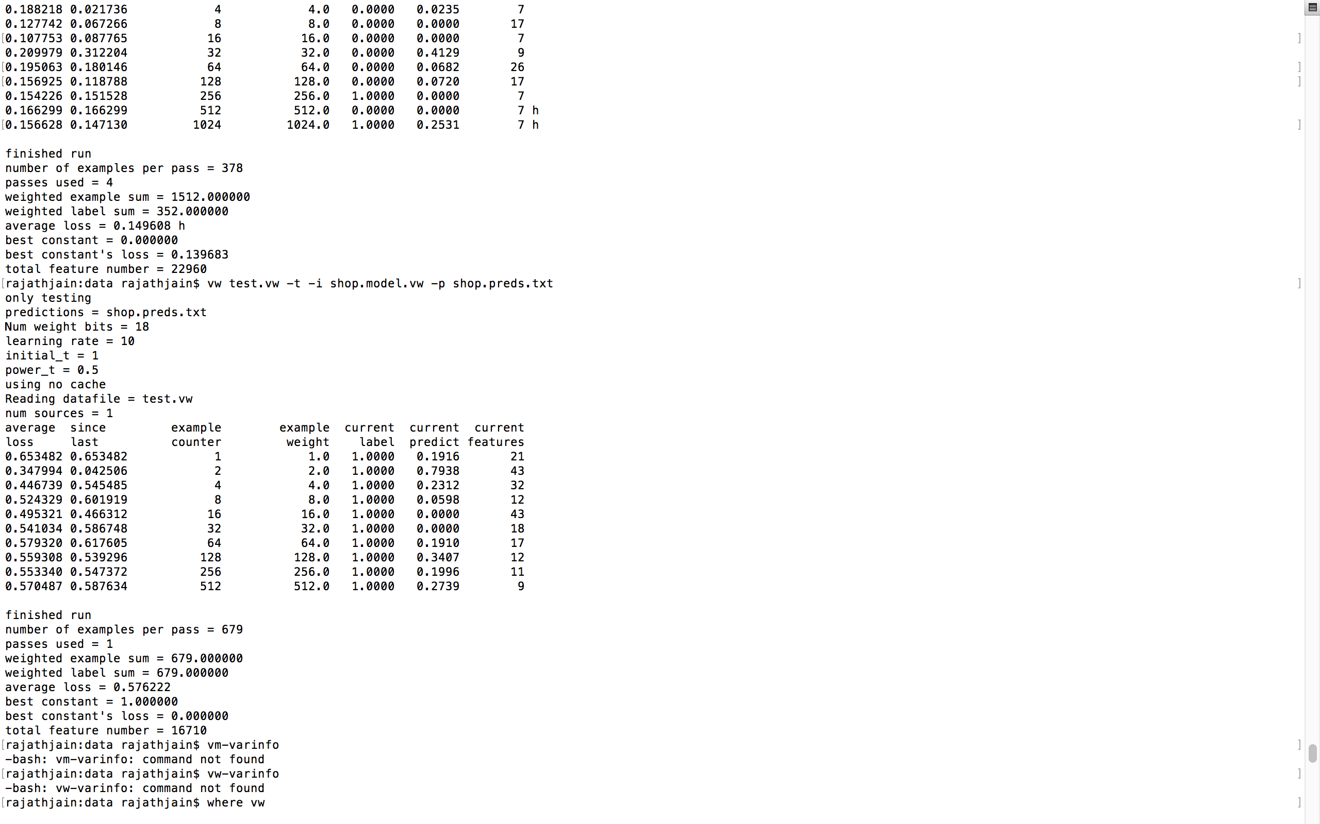

Slide 11
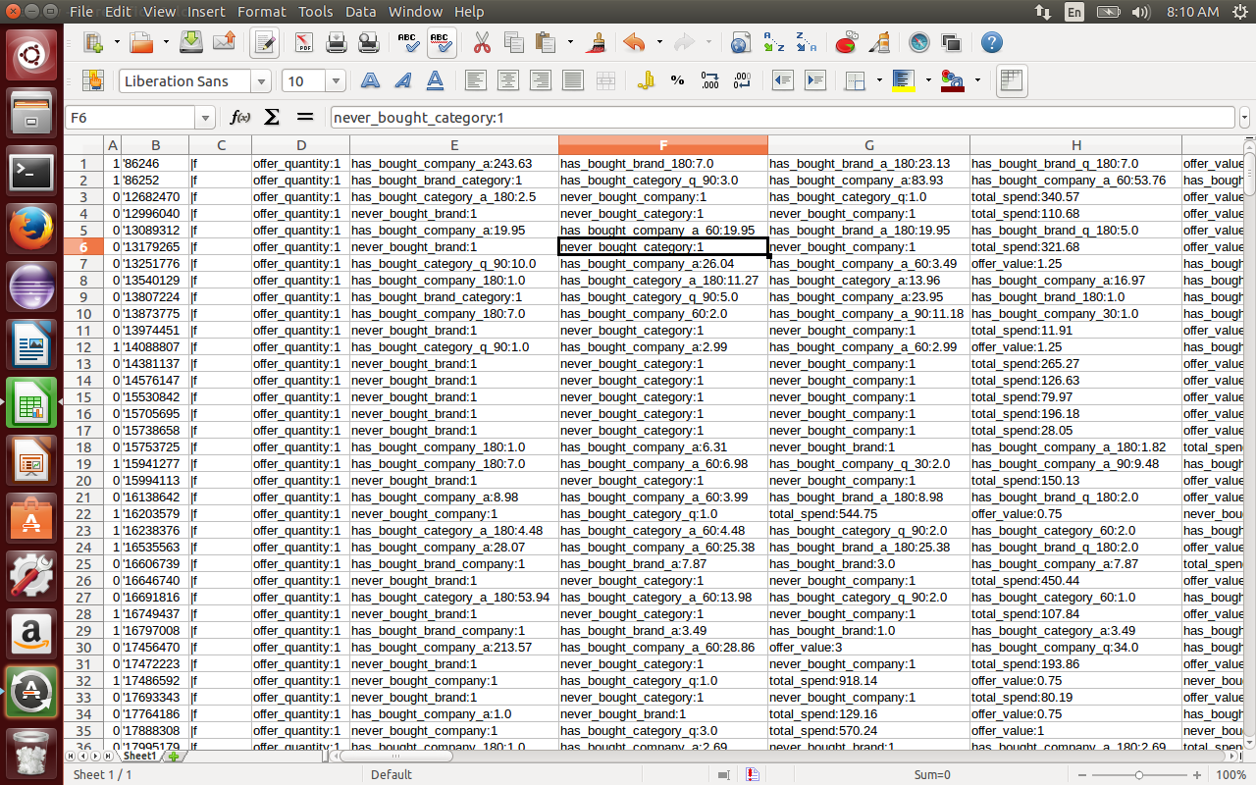

Slide 12
Conclusion and Future work
The Revisiting shopper prediction analysis is a very useful system for understanding the dealer’s perspective and more importantly the customer’s loyalty. Be it the selling of a single brand or a multi brand, it helps analyze which is the bestselling brand in the store or website. Prediction plus providing frequent customers with offers on items, enables us to understand if that particular shopper will revisit the store only on an offer day or also on a normal day. This enables the various brands as well as sellers to categorize the items and prices of these items more accurately.
The future scope of this analysis would be to identify the customer’s loyalty and behavior towards shopping in general. We would further want to make the prediction more precise so as to allow online/offline shopping sectors to benefit from our ideology.

